Slide 1

Generative Design for Precision Geo-interventions
Richard Wen and Songnian Li
Gi4DM & Urban Geoinformatics
November 2, 2022

Slide 2



Geo-interventions
Action
e.g., Reduce road speeds, Increase police patrols
Location
e.g., School zones, Crime hotspots
Outcome
e.g., Lower traffic collisions, Reduce crime

Slide 3
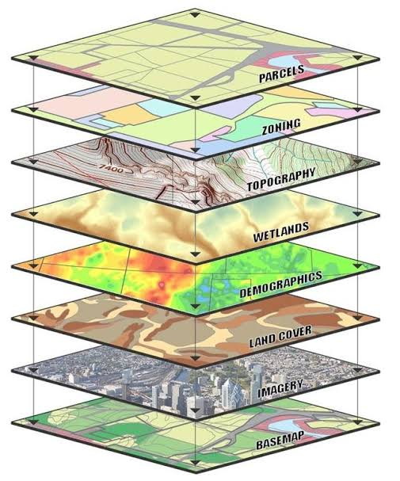
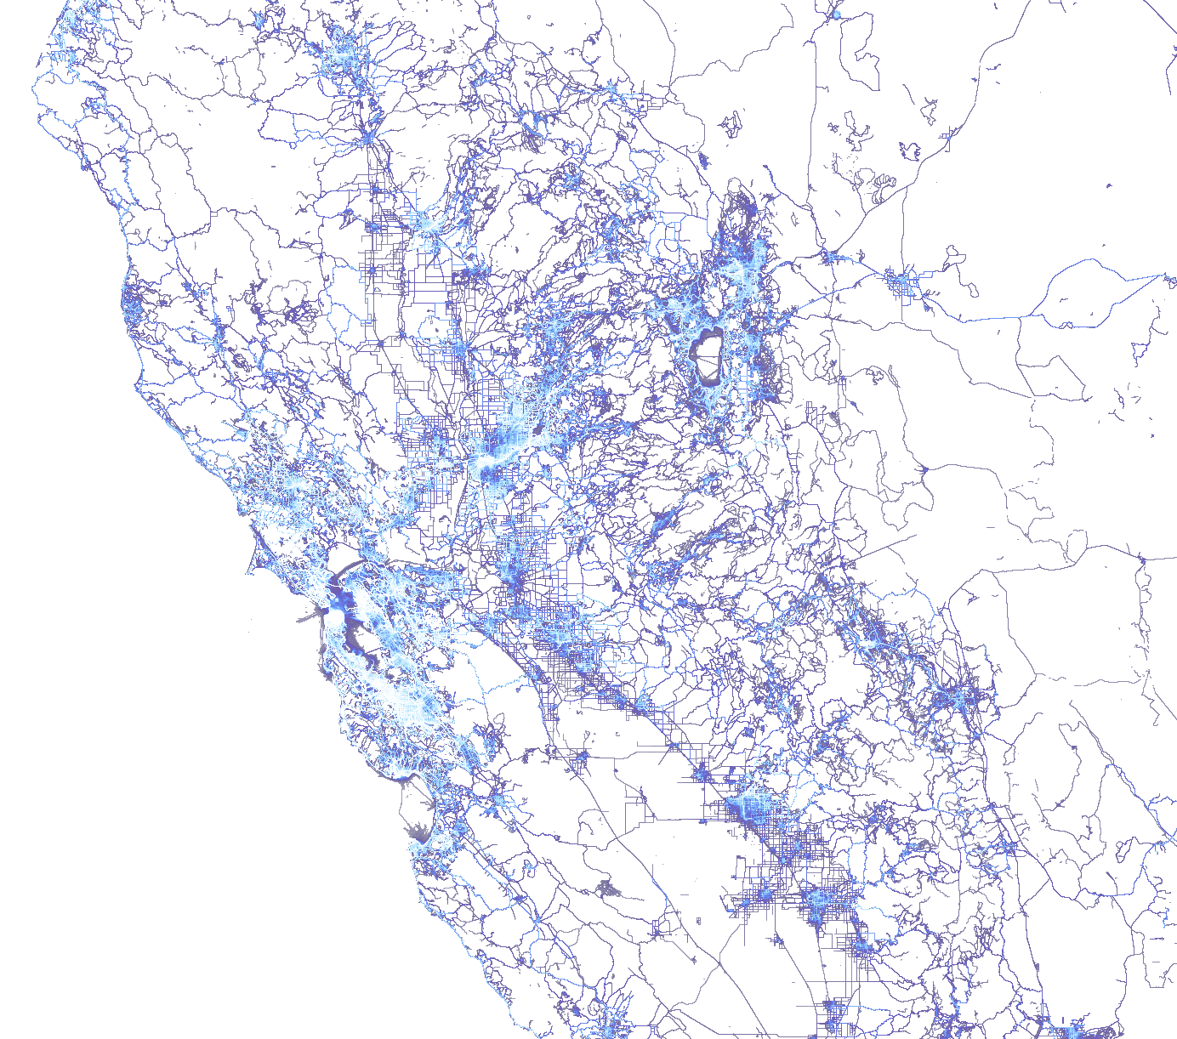
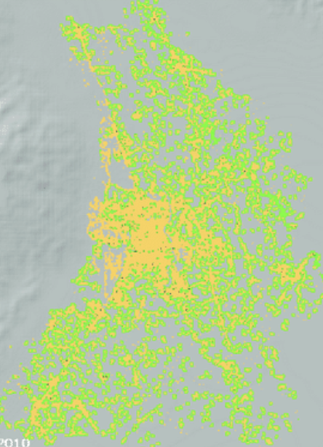
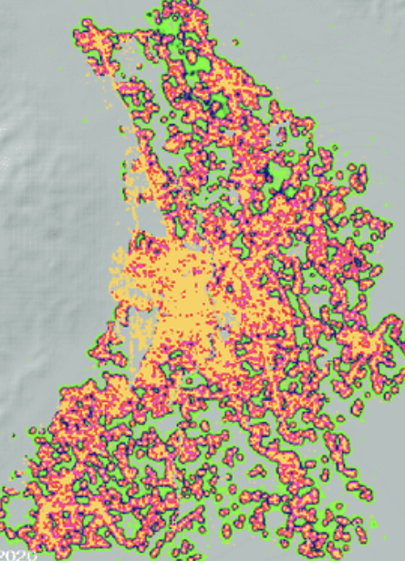
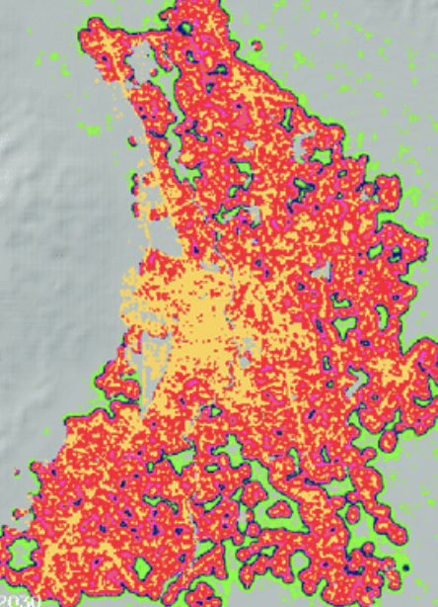
Common Approaches
Cluster
Mapping
Cellular Automata
Multi-Criteria Decision Analysis
Ref. [1-3]

Slide 4












Recent Advancements
Computing
Big Data
Automated Machine Learning (AutoML)
Ref. [4-14]

Slide 5




THEN
NOW
Expertise
Data Driven
1-10 Scenarios
100-1000 Scenarios

Slide 6


The Idea
Geodata
AutoML
Geo-interventions

Slide 7
Research Objective
Generate Geo-interventions with AutoML using Geodata
Geodata
Vector
Tabular
AutoML
Target Variable
Search Time
Geo-interventions
Variable Changes
Locatable

Slide 8

Methods
1
2
3
Geo-binning
AutoML
Prediction Optimization
Standardization
Aggregation
Spatial Joins
Preprocessing
Model Outcome
Var. Importance
Generate geo-interventions
Optimize AutoML predictions
User-guided

Slide 9

1 Geo-binning
X₁
Point
Line
X₂
…
Polygon
X_{n}
Geodata
Geo-bins
Aggregation
Geodata with geometry and variables
Spatial join geom. to each grid cell
For each grid cell, count geom. and calc. stats (sum, unique, etc) for variables
Ref. [15]

Slide 10




2 AutoML
Selection
Construction
Selection Optimization
Combination
X₁
X₂
…
X_{n}
Variables
Models
Geo-binned Data
AutoML
Outcome Model
Variable Importance
Ref. [16]

Slide 11


3 Prediction Optimization
1a
1b
2a
Variable Importance
User Design
Constraints
Outcome Model
3
2b
Generated
Geo-interventions
Prediction
Optimization
Ref. [17]

Slide 12



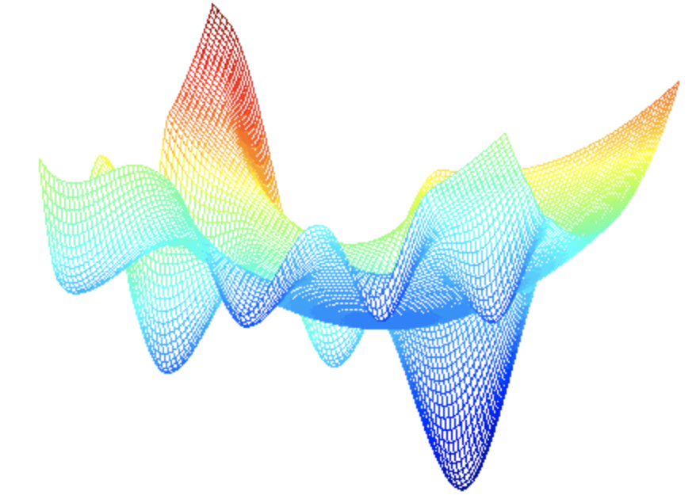



Experiment
21 Datasets
550 Variables
1,140,927 Rows
Python Packages
tpot / auto-sklearn / bayes_opt
Geo-binned Grids
10x10 / 40x40 / 80x80
Reduce Traffic Collisions
Infrastructure Changes
Ref. [12,18-21]

Slide 13
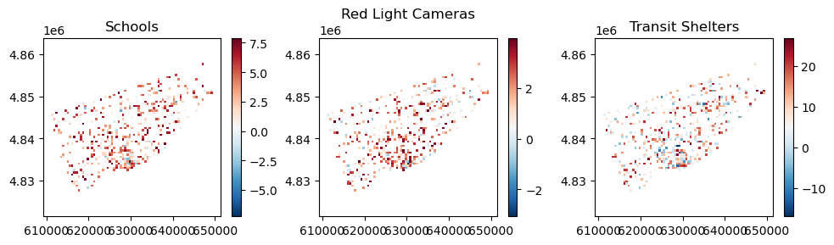
Results
Auto-Sklearn Model (80x80 grid)
117.68 Mean Absolute Error (MAE)
~50% Reduction in Traffic Collisions

Slide 14


Future Work
Interactive GUI
Exploration
Distributed AutoML & Optimization
Scalability

Slide 15
References
[1] Strava. (2022). Global Heatmap. Strava. Retrieved October 18, 2022, from https://www.strava.com/heatmap#7.00/-120.90000/38.36000/hot/all
[2] McGrath, B., Sangawongse, S., Thaikatoo, D., & Barcelloni Corte, M. (2017). The architecture of the metacity: Land use change, patch dynamics and urban form in Chiang Mai, Thailand. Urban Planning, 2(1).
[3] Nimick, S. R. and E. (2019, August 11). Multi-criteria decision analysis and GIS. ArcGIS StoryMaps. Retrieved October 18, 2022, from https://storymaps.arcgis.com/stories/b60b7399f6944bca86d1be6616c178cf
[4] https://www.ibm.com/cloud [5] https://cloud.google.com [6] https://azure.microsoft.com
[7] https://aws.amazon.com [8] https://www.kaggle.com [9] https://www.facebook.com [10] https://twitter.com
[11] https://data.nasa.gov [12] https://www.toronto.ca/city-government/data-research-maps/open-data
[13] https://data.gov [14] https://www.openstreetmap.org
[15] Brinkhoff, T., Kriegel, H. P., & Seeger, B. (1993). Efficient processing of spatial joins using R-trees. ACM SIGMOD Record, 22(2), 237-246.
[16] Waring, J., Lindvall, C., & Umeton, R. (2020). Automated machine learning: Review of the state-of-the-art and opportunities for healthcare. Artificial intelligence in medicine, 104, 101822.
[17] Snoek, J., Larochelle, H., & Adams, R. P. (2012). Practical bayesian optimization of machine learning algorithms. Advances in neural information processing systems, 25.
[18] https://data.torontopolice.on.ca/pages/open-data [19] https://pypi.org/project/TPOT
[20] https://pypi.org/project/bayesian-optimization [21] https://pypi.org/project/auto-sklearn

